Slide 1
Bitcoin Protocol and Mining
Prepared By:
Dr. Tejas M. Modi
Department of CSE
IIIT Surat

Slide 2
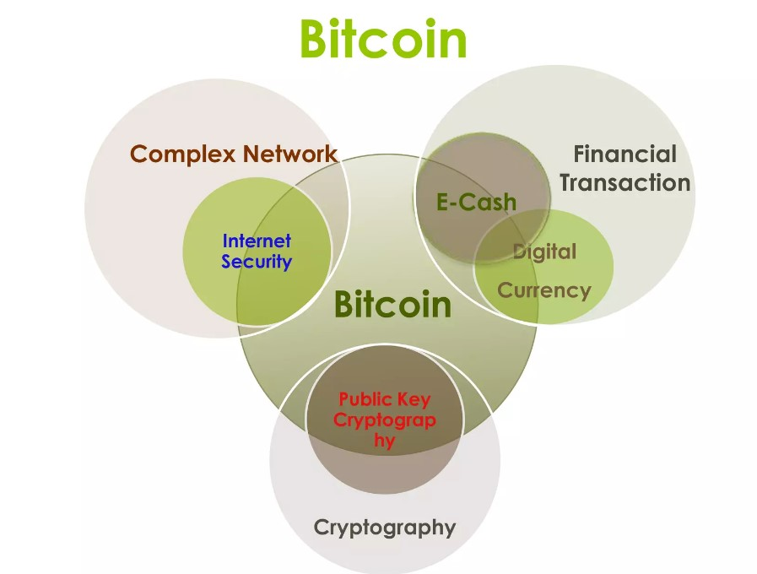

Slide 3
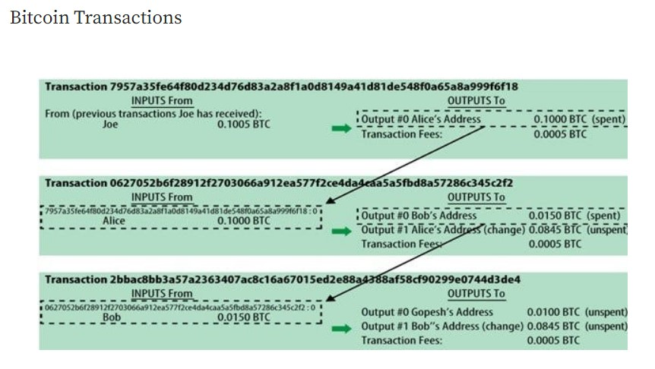

Slide 4
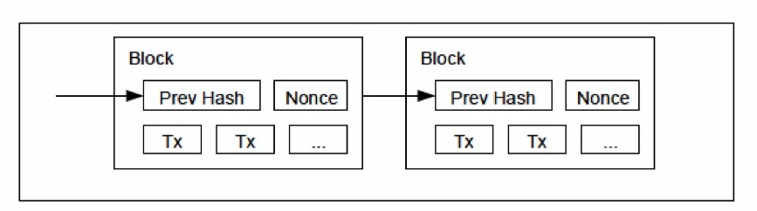
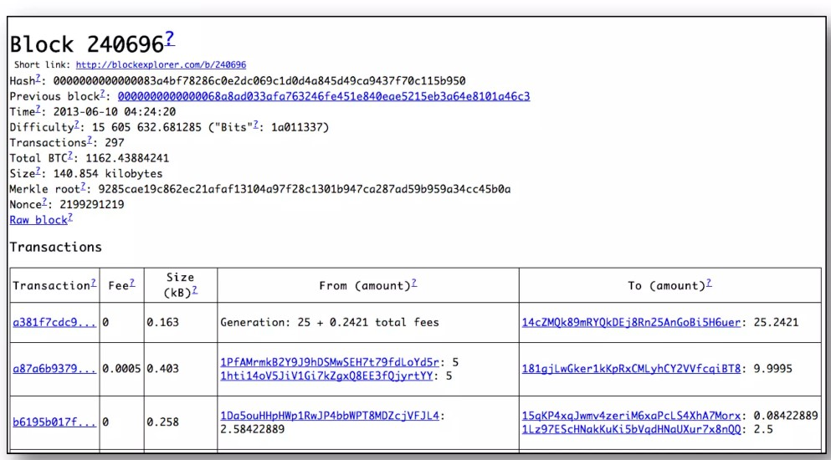

Slide 5
A Bitcoin transaction essentially contains the following information:
ID: Unique transaction ID which is the SHA256 double-hash of the transaction data.
Input: The bitcoin addresses that identify the sources of the bitcoins to be transferred. These are usually a previous transaction’s output and are used to verify the sender and check the available balance.
Amount: The number of bitcoins to be transferred.
Output: The receiver’s bitcoin address. In cases where there is leftover bitcoin change, the output should also include an entry for the sender’s address to send it back, to be collected as “Transaction Fee” or to be sent to another receiver.
Output from one transaction is used as an input for another transaction. This creates a chain of ownership as the bitcoin value is moved from address to address.

Slide 6
Transaction Validation
All digital cash transactions also need to be checked and verified for authenticity, duplicity, and cash availability. The validation of the transactions is not centralized and all participating nodes are authorized for it.
As we already know, Bitcoin uses Decentralized way of carrying out and recording transactions, their validation also is carried out in a decentralized way. All participating nodes are required to authorize a transaction. All Bitcoin wallets have a Bitcoin Address and a pair of Public and Private keys. To verify the transaction, transactions are signed digitally by using the sender’s private key and is validated by his public key that is available with all the nodes.

Slide 7
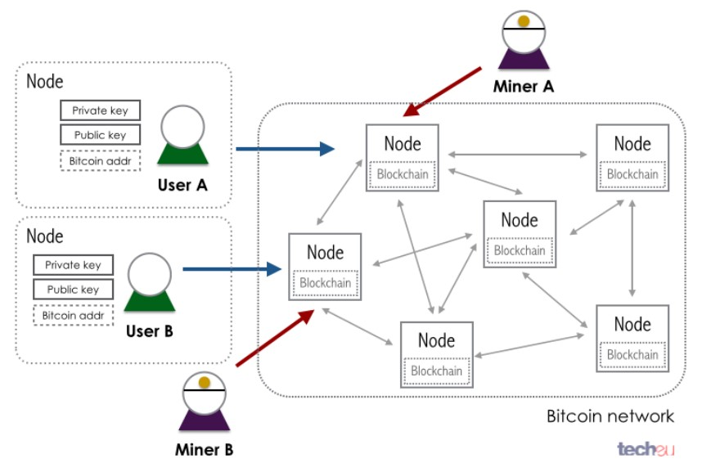
Bitcoin Protocol

Slide 8
The Bitcoin Protocol works in the following way when it comes to monitoring transactions:
A new transaction is broadcast to all participating nodes in the network.
Each node collects new transactions into a block.
Each node tries to validate the new transaction and all previous ones by finding a solution to the Proof of Work for the block.
The node which finds the solution broadcasts the solved block to the network.
Nodes validate the transactions in the block and accept the block.
Nodes start working on the next block. A hash of the last accepted block is created and used as a reference in the next block.

Slide 9
Bitcoin Mining
Mining adds new blocks to the block chain, making transaction history hard to modify.
Mining can be classified into two forms:
Solo mining, where the miner attempts to generate new blocks on his own, with the proceeds from the block reward and transaction fees going entirely to himself, allowing him to receive large payments with a higher variance (longer time between payments)
Pooled mining, where the miner pools resources with other miners to find blocks more often, with the proceeds being shared among the pool miners in rough correlation to the amount of hashing power they each contributed, allowing the miner to receive small payments with a lower variance (shorter time between payments).

Slide 10
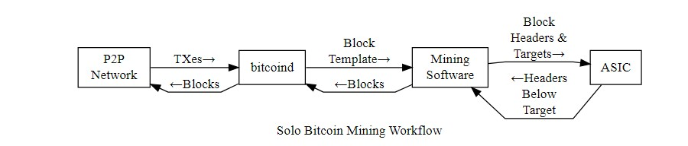
Solo Mining
As illustrated below, solo miners typically use bitcoind to get new transactions from the network. Their mining software periodically polls bitcoind for new transactions using the “getblocktemplate” RPC, which provides the list of new transactions plus the public key to which the coinbase transaction should be sent.

Slide 11
The mining software constructs a block using the template and creates a block header. It then sends the 80-byte block header to its mining hardware (an ASIC) along with a target threshold (difficulty setting). The mining hardware iterates through every possible value for the block header nonce and generates the corresponding hash.
If none of the hashes are below the threshold, the mining hardware gets an updated block header with a new merkle root from the mining software; this new block header is created by adding extra nonce data to the coinbase field of the coinbase transaction.
On the other hand, if a hash is found below the target threshold, the mining hardware returns the block header with the successful nonce to the mining software. The mining software combines the header with the block and sends the completed block to bitcoind to be broadcast to the network for addition to the block chain.

Slide 12
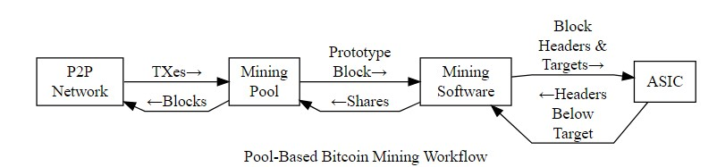
Pool Mining
Pool miners follow a similar workflow, illustrated below, which allows mining pool operators to pay miners based on their share of the work done. The mining pool gets new transactions from the network using bitcoind. Using one of the methods discussed later, each miner’s mining software connects to the pool and requests the information it needs to construct block headers.

Slide 13
In pooled mining, the mining pool sets the target threshold a few orders of magnitude higher than the network difficulty. This causes the mining hardware to return many block headers which don’t hash to a value eligible for inclusion on the block chain but which do hash below the pool’s target, proving that the miner checked a percentage of the possible hash values.
The miner then sends to the pool a copy of the information the pool needs to validate that the header will hash below the target and that the block of transactions referred to by the header merkle root field is valid for the pool’s purposes.
The information the miner sends to the pool is called a share because it proves the miner did a share of the work. By chance, some shares the pool receives will also be below the network target—the mining pool sends these to the network to be added to the block chain.

Slide 14
The block reward and transaction fees that come from mining that block are paid to the mining pool. The mining pool pays out a portion of these proceeds to individual miners based on how many shares they generated. For example, if the mining pool’s target threshold is 100 times lower than the network target threshold, 100 shares will need to be generated on average to create a successful block, so the mining pool can pay 1/100th of its payout for each share received. Different mining pools use different reward distribution systems based on this basic share system.

Slide 15


Slide 16
Bitcoin Wallets
Wallets are containers for private keys, usually implemented as structured files or simple databases.
Another method for making keys is deterministic key generation. Here you derive each new private key, using a one-way hash function from a previous private key, linking them in a sequence.
As long as you can re-create that sequence, you only need the first key (known as a seed or master key) to generate them all.
Bitcoin wallets contain keys, not coins. Each user has a wallet containing keys.
Wallets are really keychains containing pairs of private/public keys. Users sign transactions with the keys, thereby proving they own the transaction outputs (their coins). The coins are stored on the blockchain in the form of transaction-ouputs (often noted as vout or txout).

Slide 17
Nondeterministic (Random) Wallets
In the first bitcoin clients, wallets were simply collections of randomly generated private keys. This type of wallet is called a Type-0 nondeterministic wallet.
For example, the Bitcoin Core client pregenerates 100 random private keys when first started and generates more keys as needed, using each key only once. This type of wallet is nicknamed “Just a Bunch Of Keys,” or JBOK, and such wallets are being replaced with deterministic wallets because they are cumbersome to manage, back up, and import.
The disadvantage of random keys is that if you generate many of them you must keep copies of all of them, meaning that the wallet must be backed up frequently.
Each key must be backed up, or the funds it controls are irrevocably lost if the wallet becomes inaccessible.
This conflicts directly with the principle of avoiding address re-use, by using each bitcoin address for only one transaction. Address re-use reduces privacy by associating multiple transactions and addresses with each other.

Slide 18
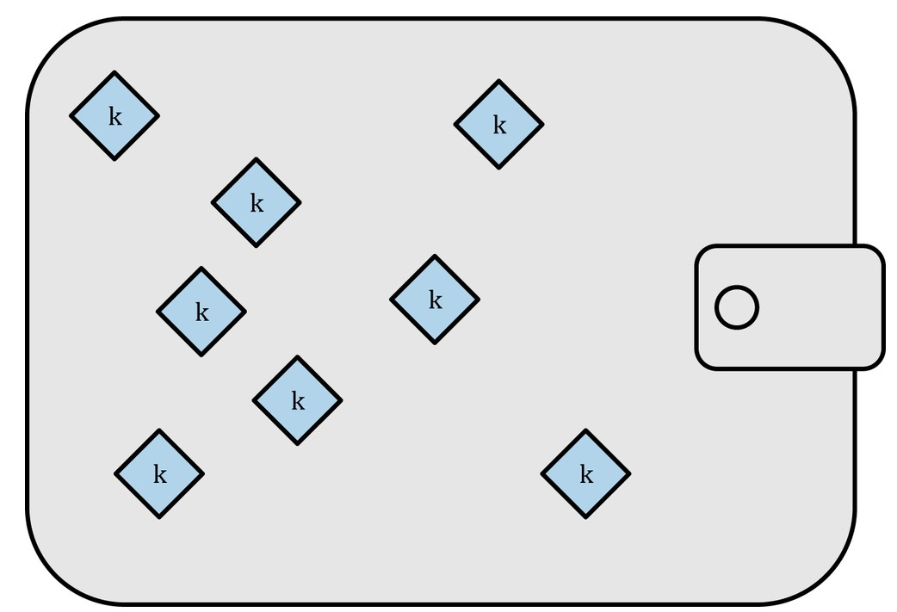
A Type-0 nondeterministic wallet is a poor choice of wallet, especially if you want to avoid address re-use because that means managing many keys, which creates the need for frequent backups.
Although the Bitcoin Core client includes a Type-0 wallet, using this wallet is discouraged by developers of Bitcoin Core.
The following Figure shows a nondeterministic wallet, containing a loose collection of random keys.

Slide 19
Hierarchical deterministic ((BIP0032/BIP0044) Wallets
Deterministic Wallets Deterministic wallets were developed to make it easy to derive many keys from a single “seed.”
The most advanced form of deterministic wallets is the hierarchical deterministic wallet or HD wallet defined by the BIP0032 standard.
Hierarchical deterministic wallets contain keys derived in a tree structure, such that a parent key can derive a sequence of children keys, each of which can derive a sequence of grandchildren keys, and so on, to an infinite depth. This tree structure is illustrated in Figure.

Slide 20
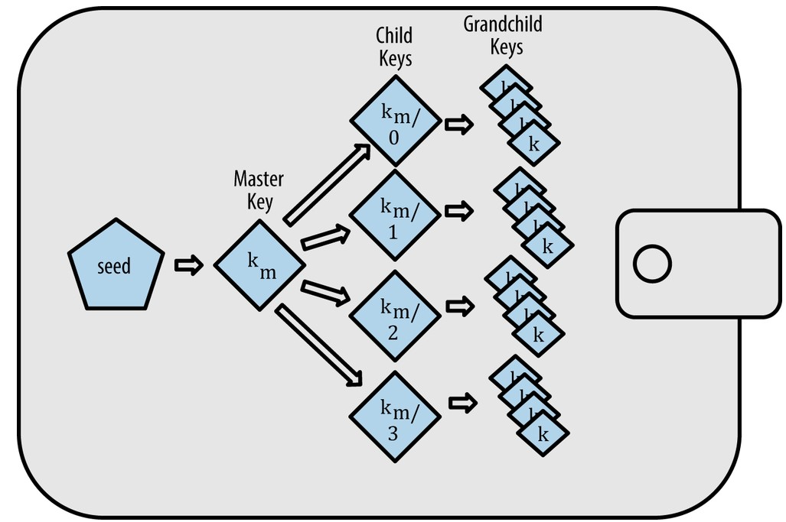

Slide 21
HD wallet creation from a seed
HD wallets are created from a single root seed, which is a 128-, 256-, or 512-bit random number.
Everything else in the HD wallet is deterministically derived from this root seed, which makes it possible to re-create the entire HD wallet from that seed in any compatible HD wallet.
This makes it easy to back up, restore, export, and import HD wallets containing thousands or even millions of keys by simply transferring only the root seed.
The root seed is most often represented by a mnemonic word sequence, as described in the previous section Mnemonic Code Words, to make it easier for people to transcribe and store it.

Slide 22
Mnemonic Code Words
Mnemonic codes are English word sequences that represent (encode) a random number used as a seed to derive a deterministic wallet.
The sequence of words is sufficient to re-create the seed and from there re-create the wallet and all the derived keys.
A wallet application that implements deterministic wallets with mnemonic code will show the user a sequence of 12 to 24 words when first creating a wallet.
That sequence of words is the wallet backup and can be used to recover and re-create all the keys in the same or any compatible wallet application.
Mnemonic code words make it easier for users to back up wallets because they are easy to read and correctly transcribe, as compared to a random sequence of numbers.

Slide 23
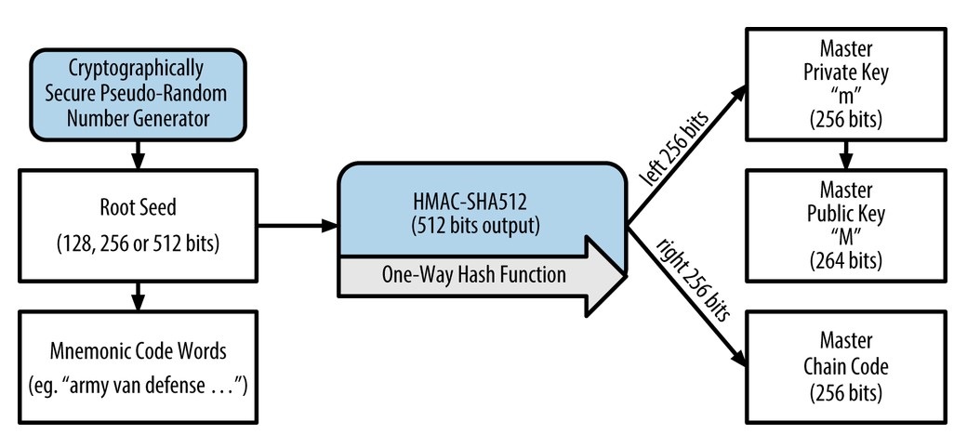
The root seed is input into the HMAC-SHA512 algorithm and the resulting hash is used to create a master private key (m) and a master chain code.
The master private key (m) then generates a corresponding master public key (M), using the normal elliptic curve multiplication process.

Slide 24
Mnemonic codes are defined in Bitcoin Improvement Proposal currently in Draft status. Note that BIP0039 is a draft proposal and not a standard. Specifically, there is a different standard, with a different set of words, used by the Electrum wallet and predating BIP0039. BIP0039 is used by the Trezor wallet and a few other wallets but is incompatible with Electrum’s implementation.
BIP0039 defines the creation of a mnemonic code and seed as a follows:
Create a random sequence (entropy) of 128 to 256 bits.
Create a checksum of the random sequence by taking the first few bits of its SHA256 hash.
Add the checksum to the end of the random sequence.
Divide the sequence into sections of 11 bits, using those to index a dictionary of 2048 predefined words.
Produce 12 to 24 words representing the mnemonic code.

Slide 25
Private child key derivation
Hierarchical deterministic wallets use a child key derivation (CKD) function to derive children keys from parent keys.
The child key derivation functions are based on a one-way hash function that combines:
A parent private or public key (ECDSA uncompressed key)
A seed called a chain code (256 bits)
An index number (32 bits)

Slide 26
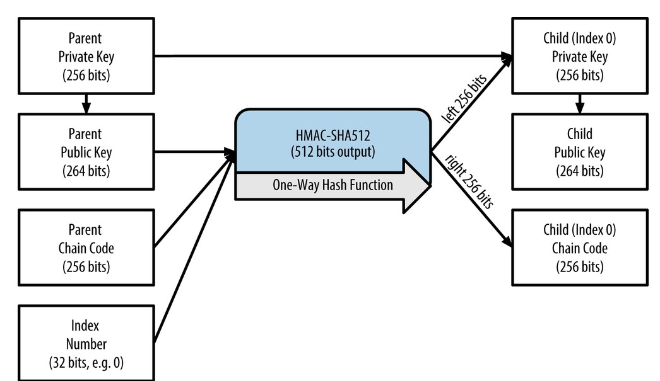
The chain code is used to introduce seemingly random data to the process, so that the index is not sufficient to derive other child keys.
Thus, having a child key does not make it possible to find its siblings, unless you also have the chain code.
The initial chain code seed (at the root of the tree) is made from random data, while subsequent chain codes are derived from each parent chain code.

Slide 27
Extended keys
As we saw earlier, the key derivation function can be used to create children at any level of the tree, based on the three inputs: a key, a chain code, and the index of the desired child.
The two essential ingredients are the key and chain code, and combined these are called an extended key. The term “extended key” could also be thought of as “extensible key” because such a key can be used to derive children.
Extended keys are stored and represented simply as the concatenation of the 256-bit key and 256-bit chain code into a 512-bit sequence.
There are two types of extended keys. An extended private key is the combination of a private key and chain code and can be used to derive child private keys (and from them, child public keys). An extended public key is a public key and chain code, which can be used to create child public keys, as described in Generating a Public Key.

Slide 28
Using derived child keys
Child private keys are indistinguishable from nondeterministic (random) keys. Because the derivation function is a one-way function, the child key cannot be used to find the parent key.
The child key also cannot be used to find any siblings. If you have the nth child, you cannot find its siblings, such as the n–1 child or the n+1 child, or any other children that are part of the sequence.
Only the parent key and chain code can derive all the children. Without the child chain code, the child key cannot be used to derive any grandchildren either.
You need both the child private key and the child chain code to start a new branch and derive grandchildren.

Slide 29
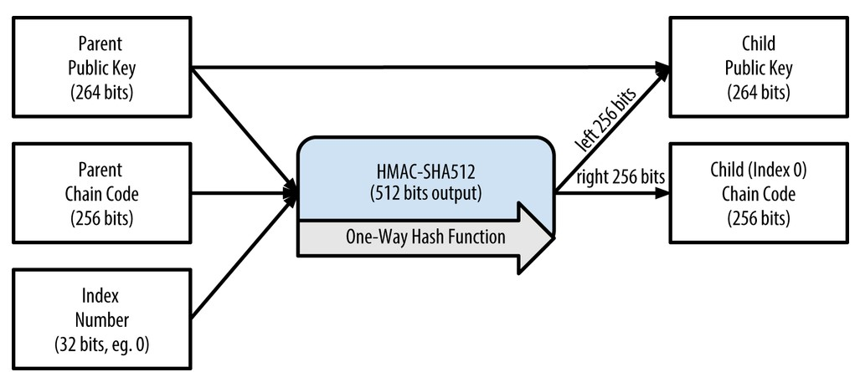
Public child key derivation
As mentioned previously, a very useful characteristic of hierarchical deterministic wallets is the ability to derive public child keys from public parent keys, without having the private keys. This gives us two ways to derive a child public key: either from the child private key, or directly from the parent public key.

Slide 30
An extended public key can be used, therefore, to derive all of the public keys (and only the public keys) in that branch of the HD wallet structure.
This shortcut can be used to create very secure public-key-only deployments where a server or application has a copy of an extended public key and no private keys whatsoever.
That kind of deployment can produce an infinite number of public keys and bitcoin addresses, but cannot spend any of the money sent to those addresses. Meanwhile, on another, more secure server, the extended private key can derive all the corresponding private keys to sign transactions and spend the money.
One common application of this solution is to install an extended public key on a web server that serves an ecommerce application.
The web server can use the public key derivation function to create a new bitcoin address for every transaction (e.g., for a customer shopping cart).

Slide 31
The web server will not have any private keys that would be vulnerable to theft. Without HD wallets, the only way to do this is to generate thousands of bitcoin addresses on a separate secure server and then preload them on the ecommerce server.
That approach is cumbersome and requires constant maintenance to ensure that the ecommerce server doesn’t “run out” of keys.
Another common application of this solution is for cold-storage or hardware wallets. In that scenario, the extended private key can be stored on a paper wallet or hardware device (such as a Trezor hardware wallet), while the extended public key can be kept online.
The user can create “receive” addresses at will, while the private keys are safely stored offline. .
To spend the funds, the user can use the extended private key on an offline signing bitcoin client or sign transactions on the hardware wallet device (e.g., Trezor).

Slide 32
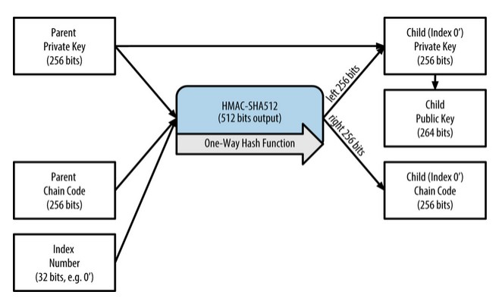
Hardened child key derivation
The ability to derive a branch of public keys from an extended public key is very useful, but it comes with a potential risk. Access to an extended public key does not give access to child private keys. However, because the extended public key contains the chain code, if a child private key is known, or somehow leaked, it can be used with the chain code to derive all the other child private keys.
A single leaked child private key, together with a parent chain code, reveals all the private keys of all the children. Worse, the child private key together with a parent chain code can be used to deduce the parent private key.

Slide 33
To counter this risk, HD wallets use an alternative derivation function called hardened derivation, which “breaks” the relationship between parent public key and child chain code.
The hardened derivation function uses the parent private key to derive the child chain code, instead of the parent public key. This creates a “firewall” in the parent/child sequence, with a chain code that cannot be used to compromise a parent or sibling private key.
The hardened derivation function looks almost identical to the normal child private key derivation, except that the parent private key is used as input to the hash function, instead of the parent public key.
When the hardened private derivation function is used, the resulting child private key and chain code are completely different from what would result from the normal derivation function.
The resulting “branch” of keys can be used to produce extended public keys that are not vulnerable, because the chain code they contain cannot be exploited to reveal any private keys.
Hardened derivation is therefore used to create a “gap” in the tree above the level where extended public keys are used.

Slide 34
Vanity Addresses
Vanity addresses are valid bitcoin addresses that contain human-readable messages. For example, 1LoveBPzzD72PUXLzCkYAtGFYmK5vYNR33 is a valid address that contains the letters forming the word “Love” as the first four Base-58 letters.
Vanity addresses require generating and testing billions of candidate private keys, until one derives a bitcoin address with the desired pattern. Although there are some optimizations in the vanity generation algorithm, the process essentially involves picking a private key at random, deriving the public key, deriving the bitcoin address, and checking to see if it matches the desired vanity pattern, repeating billions of times until a match is found.
Once a vanity address matching the desired pattern is found, the private key from which it was derived can be used by the owner to spend bitcoins in exactly the same way as any other address. Vanity addresses are no less or more secure than any other address.
They depend on the same Elliptic Curve Cryptography (ECC) and Secure Hash Algorithm (SHA) as any other address. You can no more easily find the private key of an address starting with a vanity pattern than you can any other address.

Slide 35
Vanity Addresses Security
Vanity addresses can be used to enhance and to defeat security measures; they are truly a double-edged sword. Used to improve security, a distinctive address makes it harder for adversaries to substitute their own address and fool your customers into paying them instead of you. Unfortunately, vanity addresses also make it possible for anyone to create an address that resembles any random address, or even another vanity address, thereby fooling your customers.
Eugenia could advertise a randomly generated address (e.g., 1J7mdg5rbQyUHENYdx39WVWK7fsLpEoXZy) to which people can send their donations. Or, she could generate a vanity address that starts with 1Kids, to make it more distinctive.
In both cases, one of the risks of using a single fixed address (rather than a separate dynamic address per donor) is that a thief might be able to infiltrate your website and replace it with his own address, thereby diverting donations to himself.

Slide 36
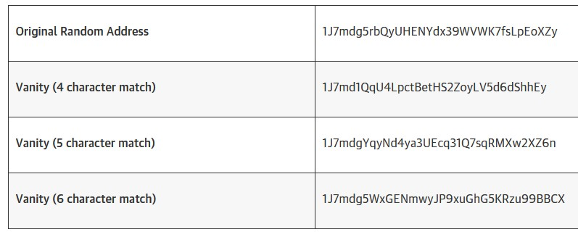
If you have advertised your donation address in a number of different places, your users may visually inspect the address before making a payment to ensure it is the same one they saw on your website, on your email, and on your flyer.
In the case of a random address like 1J7mdg5rbQyUHENYdx39WVWK7fsLpEoXZy, the average user will perhaps inspect the first few characters “1J7mdg” and be satisfied that the address matches.
Using a vanity address generator, someone with the intent to steal by substituting a similar-looking address can quickly generate addresses that match the first few characters.

Slide 37
Paper Wallets
Paper wallets are bitcoin private keys printed on paper. Often the paper wallet also includes the corresponding bitcoin address for convenience, but this is not necessary because it can be derived from the private key.
Paper wallets are a very effective way to create backups or offline bitcoin storage, also known as “cold storage.” As a backup mechanism, a paper wallet can provide security against the loss of key due to a computer mishap such as a hard drive failure, theft, or accidental deletion.
As a “cold storage” mechanism, if the paper wallet keys are generated offline and never stored on a computer system, they are much more secure against hackers, key-loggers, and other online computer threats.
Paper wallets come in many shapes, sizes, and designs, but at a very basic level are just a key and an address printed on paper.

Slide 38

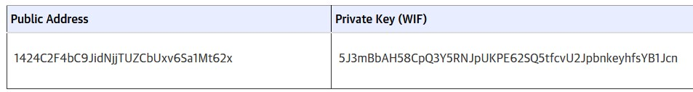
Paper wallets can be generated easily using a tool such as the client-side JavaScript generator at bitaddress.org. This page contains all the code necessary to generate keys and paper wallets, even while completely disconnected from the Internet.
To use it, save the HTML page on your local drive or on an external USB flash drive. Disconnect from the Internet and open the file in a browser. Even better, boot your computer using a pristine operating system, such as a CD-ROM bootable Linux OS. Any keys generated with this tool while offline can be printed on a local printer over a USB cable (not wirelessly), thereby creating paper wallets whose keys exist only on the paper and have never been stored on any online system.
Put these paper wallets in a fireproof safe and “send” bitcoin to their bitcoin address, to implement a simple yet highly effective “cold storage” solution.

